Slide 1


Assignment 1 – Reconnaissance and phishing cybr3040 Human security
Prepared By:
Arr Domingo

Slide 2


Target Profile
***Disclaimer: This is based on a real experience happened 4 years ago where I was the target and lost almost $1000. The message in the email is not the exact message I received from attacker as I needed to edit per requirement of this assignment, but the way I was socially-engineered is like that.
Target Person: Arr
Type of Work: Online seller
Location: Edmonton, AB
Nationality: Filipino
Item Sold Online: Brand new gaming chair and desk
Cost of both items: $320
Online Platform: Facebook marketplace, Kijiji.com
Other details: Contact info is updated online
Form of Info Gathering: Facebook account, Kijiji account, LinkedIn account
Tools/Resources Used: Text message, Email, Fake Cheque, Believable Story
Reason of Phishing Attack:
- Target looks poor and desperate to get a sale. He’ll be happy if he get one.
- Target seems easy to build rapport with.
- Since the target looks like not originally from Canada, seems it is easy to manipulate/control.
- Target seems easy to give trust if there is a good and believable story in place.
Method of Attack:
Send a text message to inquire about the item/product and to gain trust.
Once trust is in place, create a story that will make him believe that the intention is real.
Send an email about payment method with attached fake cheque.

Slide 3

To: domingo.arrbelrey@gmail.com
Subject: Cheque and Deposit Instructions for the chair and desk
Hi Arr,
As stated in my text message to you, the item you posted online looks fabulous. The desk and the gaming chair fits perfectly in my room, and this is exactly what I am looking for. It is also way more affordable compared to others, that is why I am buying both items.
I know you are selling them for only $320, but I have made out a cheque for $590. My mover will pickup the items, but you need to first deposit and give the extra $270 to my mover as he has other stuff to pick up for me. Once you deposit the money, the mover will contact you.
With that being said, please find the attached cheque and steps to have it deposited per adventure. If you are not familiar with mobile deposits, this is how you do it.
I have called my bank to have the cheque approved so you should have the funds credited into your account upon deposit. Let me know when you have it cleared in your account.
Cheers,
Lilly
Arr Belrey Domingo -590-Approved by TD Canada for Mobile Deposit Only.jpg (746K)

Slide 4
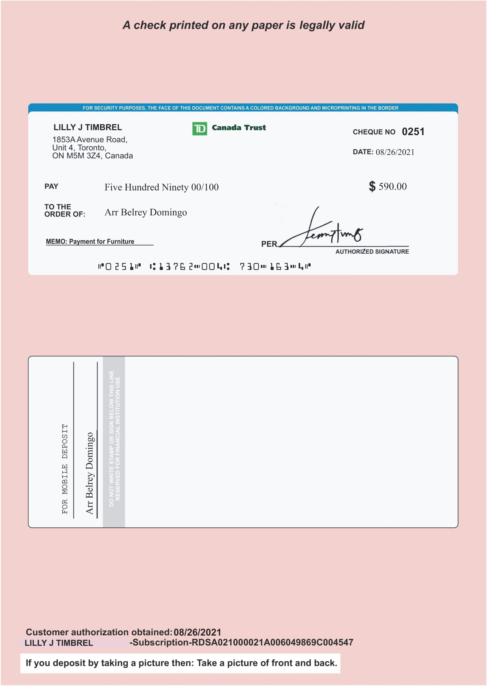
Fake Cheque Attachment
Arr Belrey Domingo -590-Approved by TD Canada for Mobile Deposit Only.jpeg

Slide 5


